Slide 1
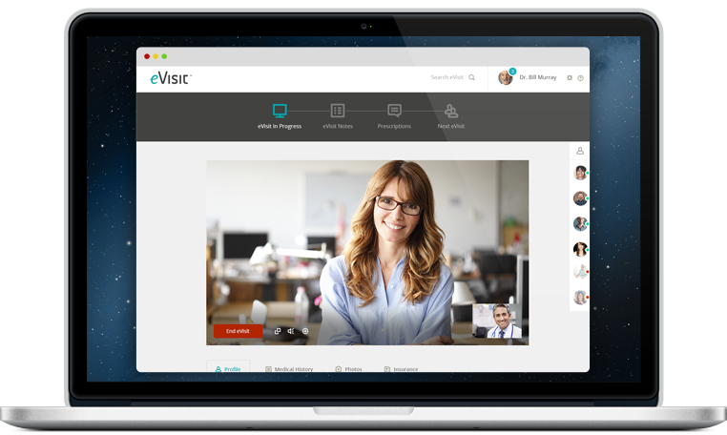
Ficht LLC - Adoption Guide

Slide 2
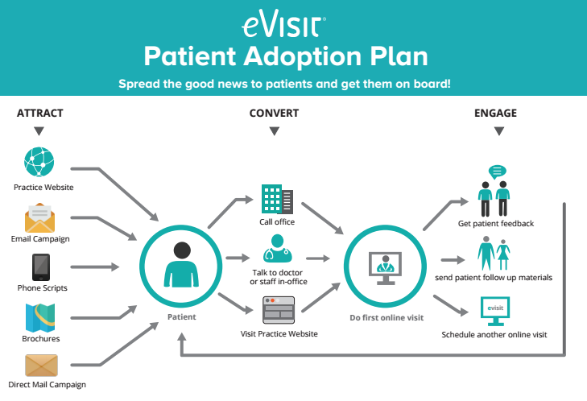
Patient adoption workflow:
Notes:
Notes

Slide 3
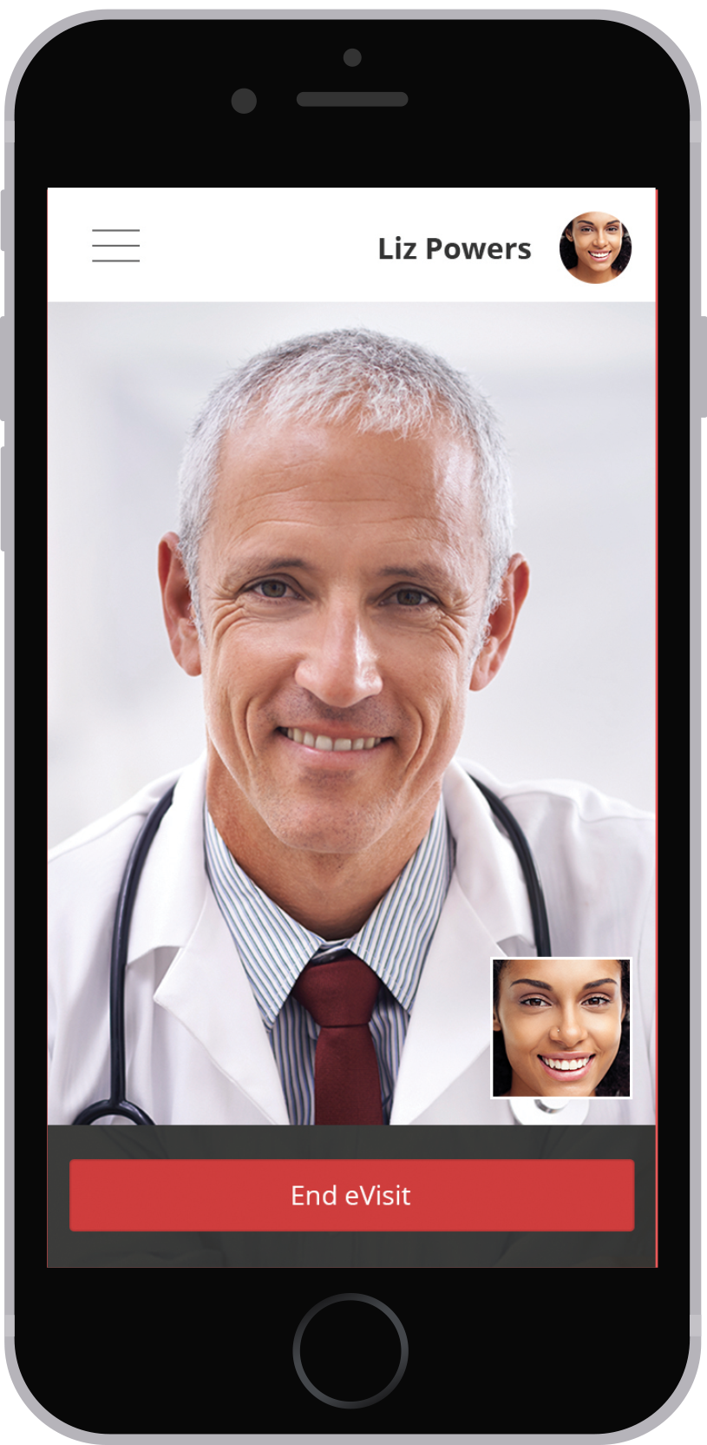
Important Links
Enrollment Link: https://app.evisit.com/ng/#/enroll/ficht
Buttons Link: http://resources.evisit.com/#ficht
Telemedicine Video: https://www.youtube.com/watch?v=h72vbuu40Dg
Resource Library: http://evisit.com/free-telehealth-resource-library/

Slide 4
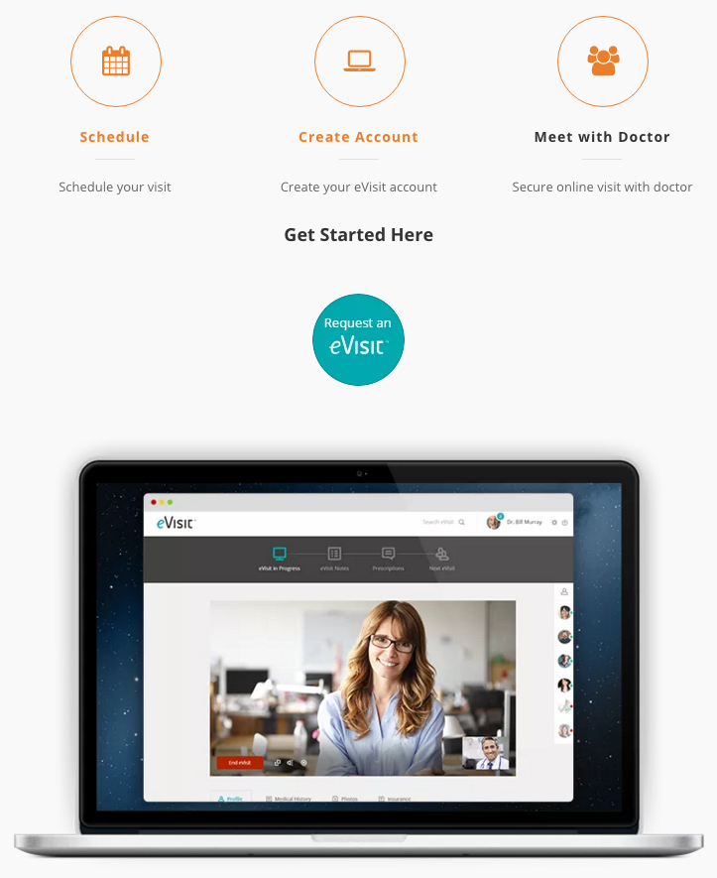
Updating website with patient sign up process
Notes:
Notes

Slide 5
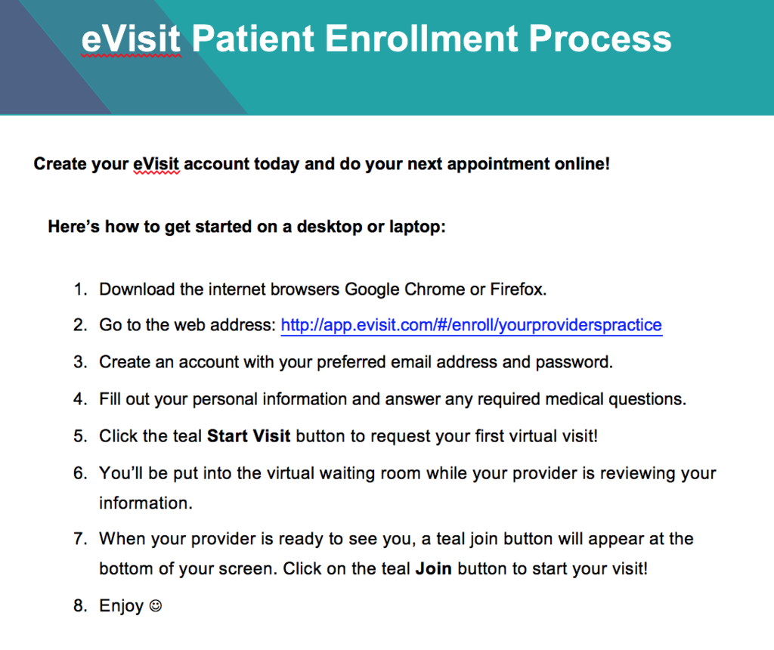
Once scheduled send sign up instructions or have on website
Notes:
Notes

Slide 6
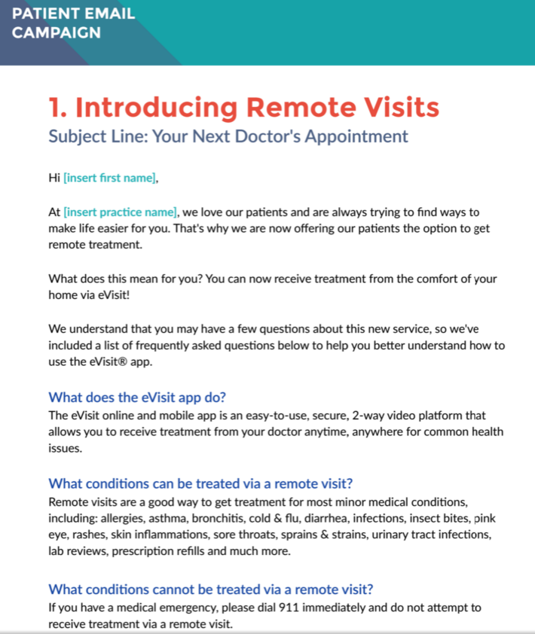
Invite patients for their first eVisit
Notes:
Notes

Slide 7
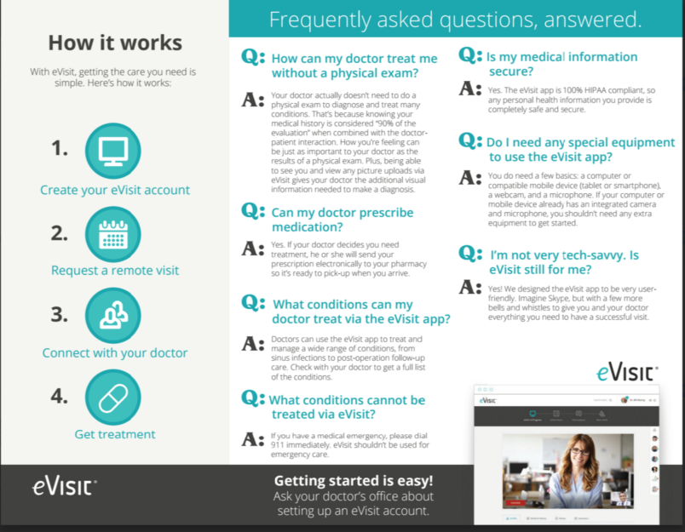
Use patient brochures to educate patients in office
Notes:
Notes

Slide 8
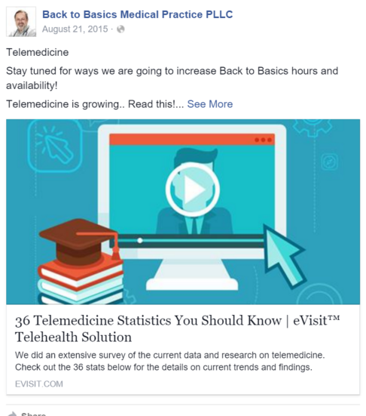
Update social media channels with Telehealth content
Notes:
Notes

Slide 9
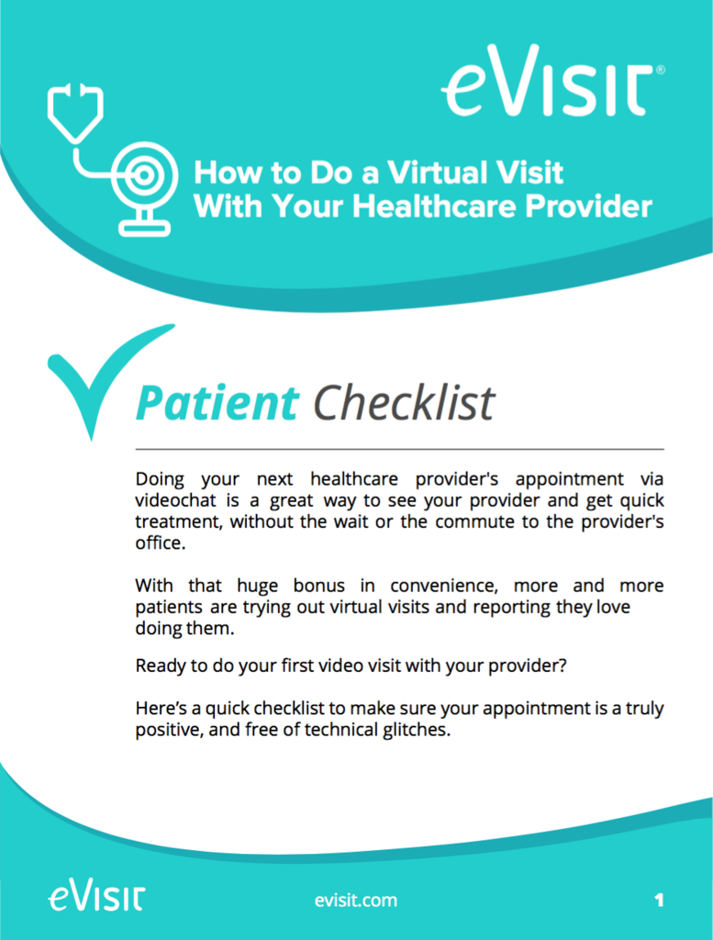
Important Checklists
Notes:
Notes

Slide 10
eVisit Goals
What will be your default price? | No charge to start
How many eVisits will you do weekly? | Max 6-8 / day for 2 providers (Goal) Start: 1 slot in morning and afternoon a day 5 visits a week goal to start
When will you do your first eVisit? | Last week of March for test patients

Slide 11
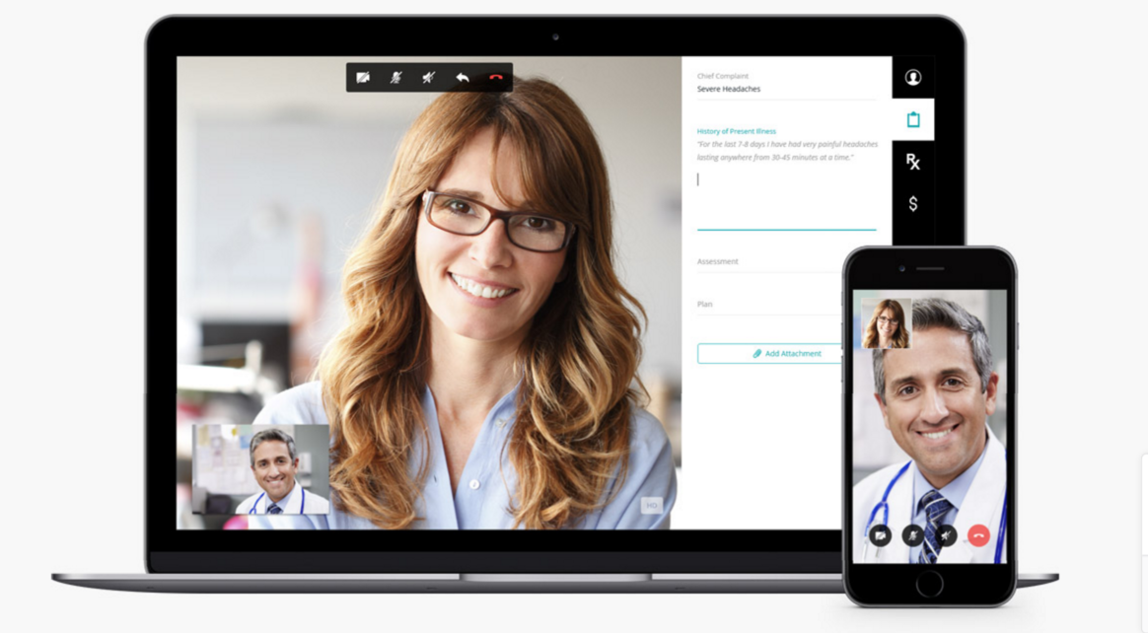
Next steps:
Are there any other questions we can answer for you?
Do you feel you have everything you need to launch eVisit?
Notes:
Notes

